Slide 1
RANDOM FOREST ALGORITHM

Slide 2
Introduction
Random Forest is a supervised Machine learning algorithm
Used in regression and classification.
Produces great results most of the time even without hyperparameter tuning.
Perhaps the most used algorithm because of its simplicity.
Firstly, it builds a number of decision trees on different samples.
In case of classification, it takes a majority vote.
In case of regression, it takes average.

Slide 3
Ensemble Techniques
Ensemble Technique combines multiple models
A collection of models is used to make predictions rather than an individual model.
This will increase the overall performance.
2 main ensemble methods in Machine Learning:
1. Bagging
2. Boosting

Slide 4
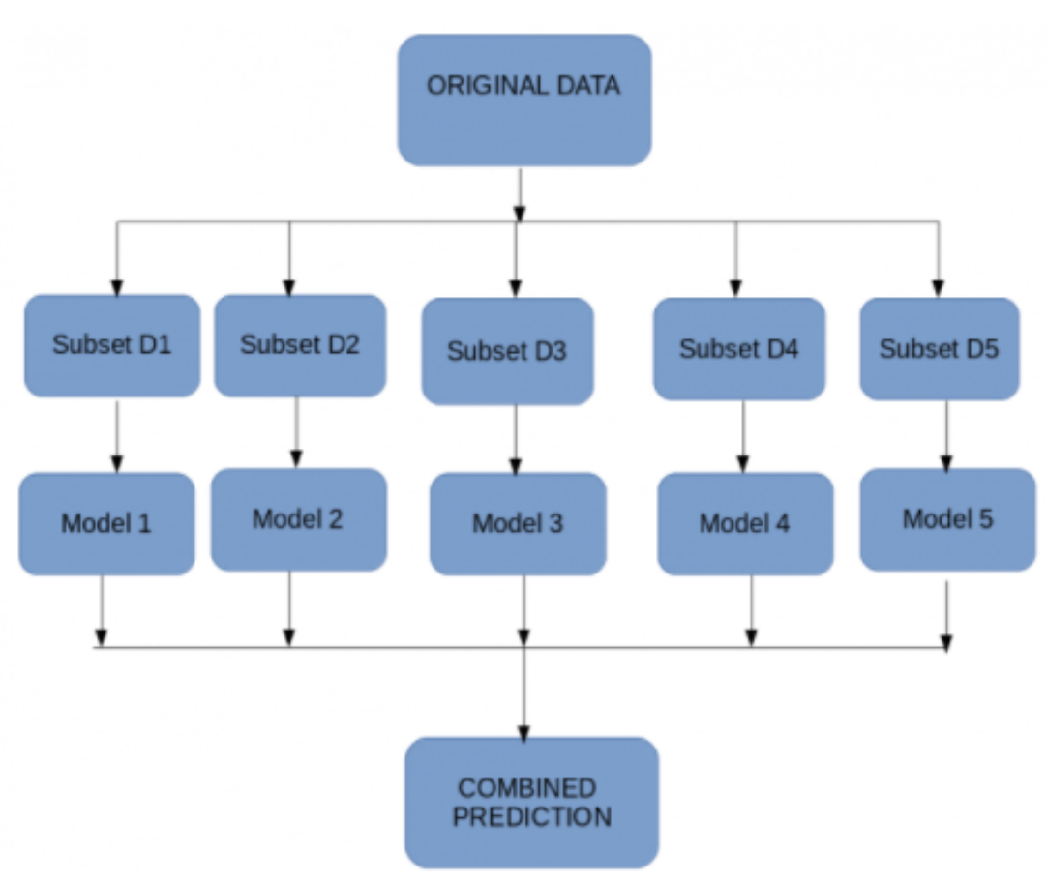
BAGGING
A technique called bootstrapping is used.
We create subsets of the original dataset with replacement.
The size of the subsets is the same as the size of the original set.
Since we use replacements, different data points are provided.

Slide 5
BOOSTING
Boosting technique is a sequential process.
Combines weak learners into strong learners by creating sequential models
Each model tries to correct the errors of the previous model.
The succeeding models are dependent on the previous model.
The final model has the highest accuracy.

Slide 6
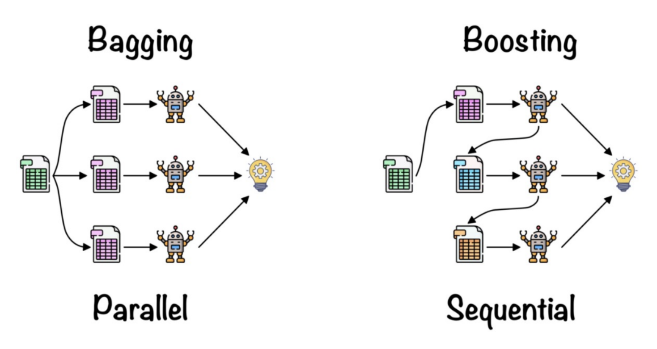

Slide 7
Why Random Forest?
When we grow our decision tree to its depth, Overfitting can occur, i.e. we get Low Bias and High Variance.
Our model will perform well on our training dataset, but it’ll underperform when a new datapoint comes into the picture.
To tackle this high variance situation, we use Random Forest.

Slide 8
Random Forest Algorithm - Steps
STEP 1 : We first make subsets of our original data. We will do row sampling and feature sampling that means we’ll select rows and columns with replacement and create subsets of the training dataset
STEP 2 : We create an individual decision tree for each subset we take
STEP 3 : Each decision tree will give an output
STEP 4 : Final output is considered based on Majority Voting if it’s a classification problem and average if it’s a regression problem.

Slide 9
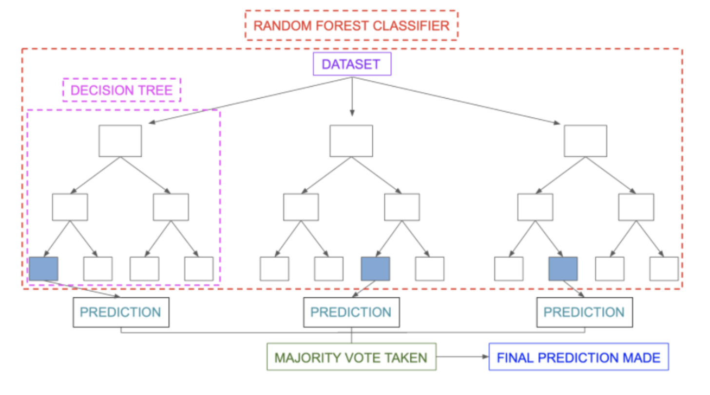

Slide 10
Decision Trees | Random Forest
Normally suffer from the problem of overfitting if it’s allowed to grow till its maximum depth. | Uses bagging method, which creates a subset of the original dataset, and the final output is based on majority ranking and hence the problem of overfitting is taken care of.
A single decision tree is faster in computation | It is comparatively slower.
When a data set with features is taken as input by a decision tree it will formulate some set of rules to do prediction. | Random forest randomly selects observations, builds a decision tree and the average result is taken. It doesn’t use any set of formulas.

Slide 11
Advantages of Random Forest
Flexibility: We can use this algorithm for regression as well as classification.
Produces better results even without hyperparameter tuning.
Overcomes overfitting

Slide 12
Limitations of Random Forest
Slow: Due to a large number of trees the algorithm takes high training time
Ineffective for real-time predictions
In most real-world applications, the random forest algorithm is fast enough but there may be situations where run-time performance is critical.

Slide 13
Applications of Random Forest
Finance
Healthcare
E-Commerce
Trading
Insurance
Retail

Slide 14
THANK YOU !

